Slide 1
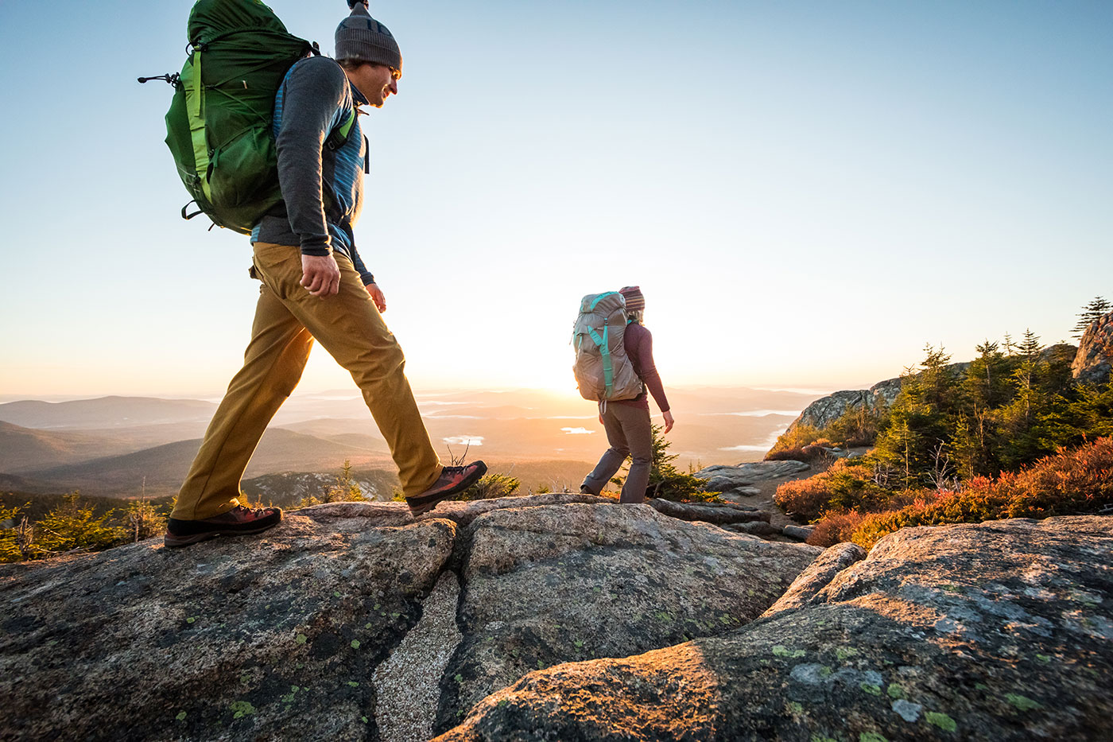
Hike with a view
Tatiana Konstantinova

Slide 2




Hiking in the USA
45M hike each year
“Observing scenic beauty”
in top 5 reasons
for getting outdoors
~ 2500 trails in NY
Which one will please your eye?
Statics source: https://www.statista.com/
Notes:
Everyone defines scenery differently. Some like forest, some like mountains, some prefer deserts. There are variety of different trails. Even NY state alone have around 2500. It is hard to select a trail which will please your eye.

Slide 3
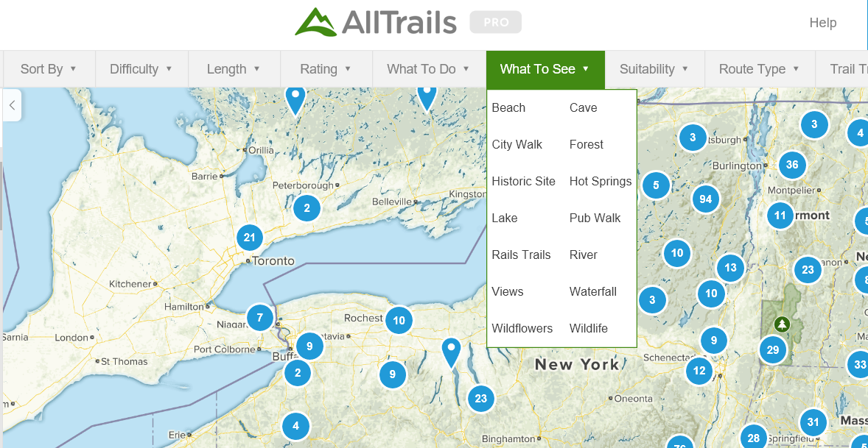
Current solution for trail selection
Customer:
Where near A can I see mountains, valley and cliff…just as I saw at B?

Slide 4



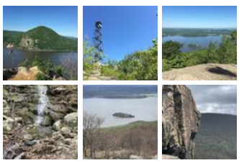
My approach
Data
Feature Engineering
Model
Product
length | 10
elevation | 2563
User Input: favorite trail
similarity ranking
Web-App
NY State
lake | 0.5
cliff | 0.15
creek | 0.11
forest | 0.08
Recommended:
Trail 1
Trail 2
Trail 3
K -means clustering
ResNet
CNN
(by MIT)
“Visual” features:
Photo content
Notes:
Add validations/ think about other approaches
What is the model

Slide 5
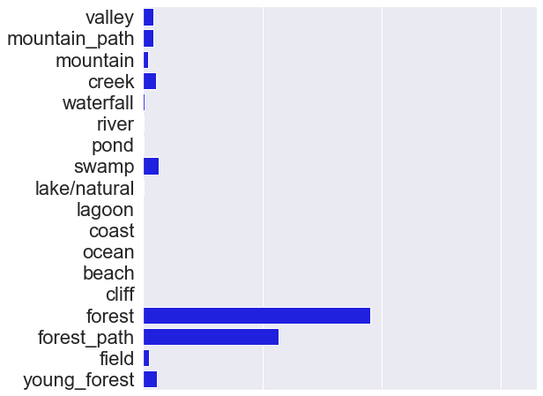
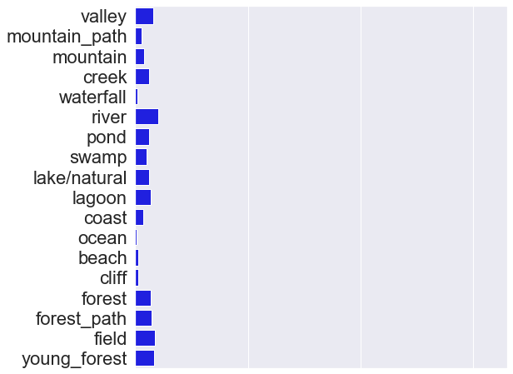
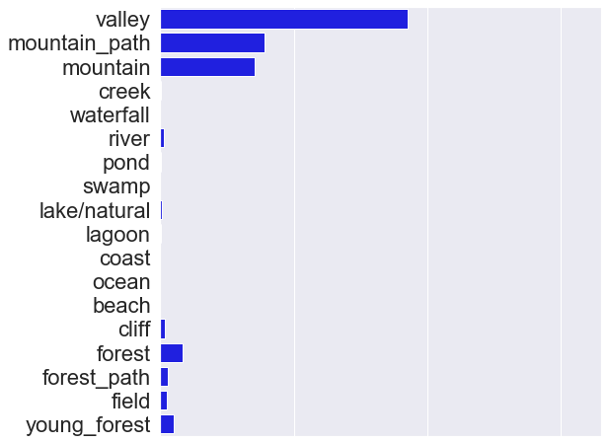
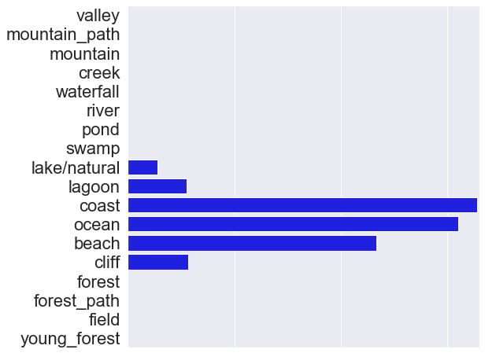
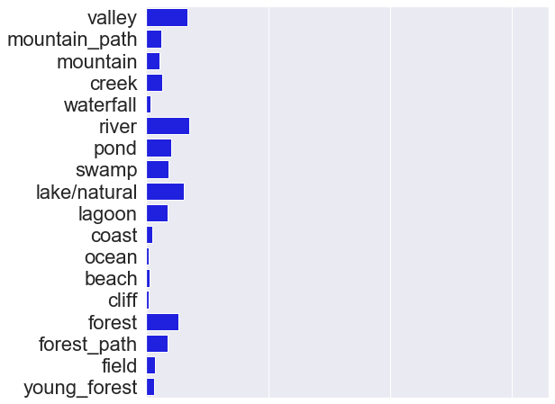
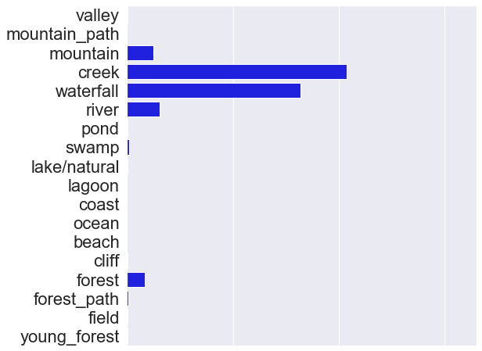
Trails Views Groups
Forest
a little bit of everything
Mountain
K-mean clustering
Coast
River / Lake
Waterfalls

Slide 6
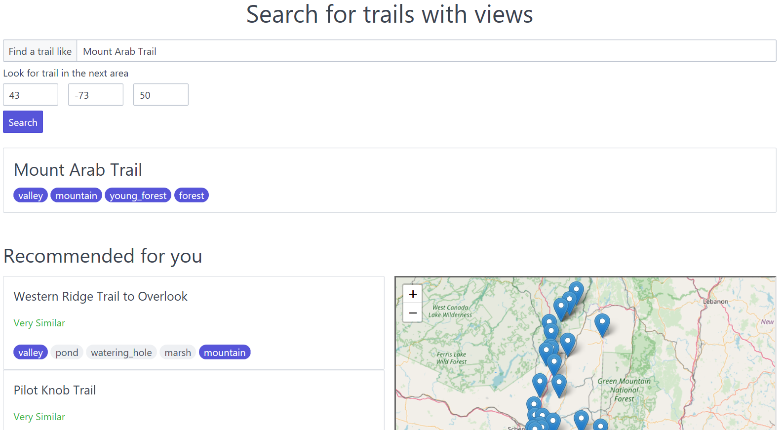
Web App
demo webpage
Notes:
Ask audience suggestions

Slide 7

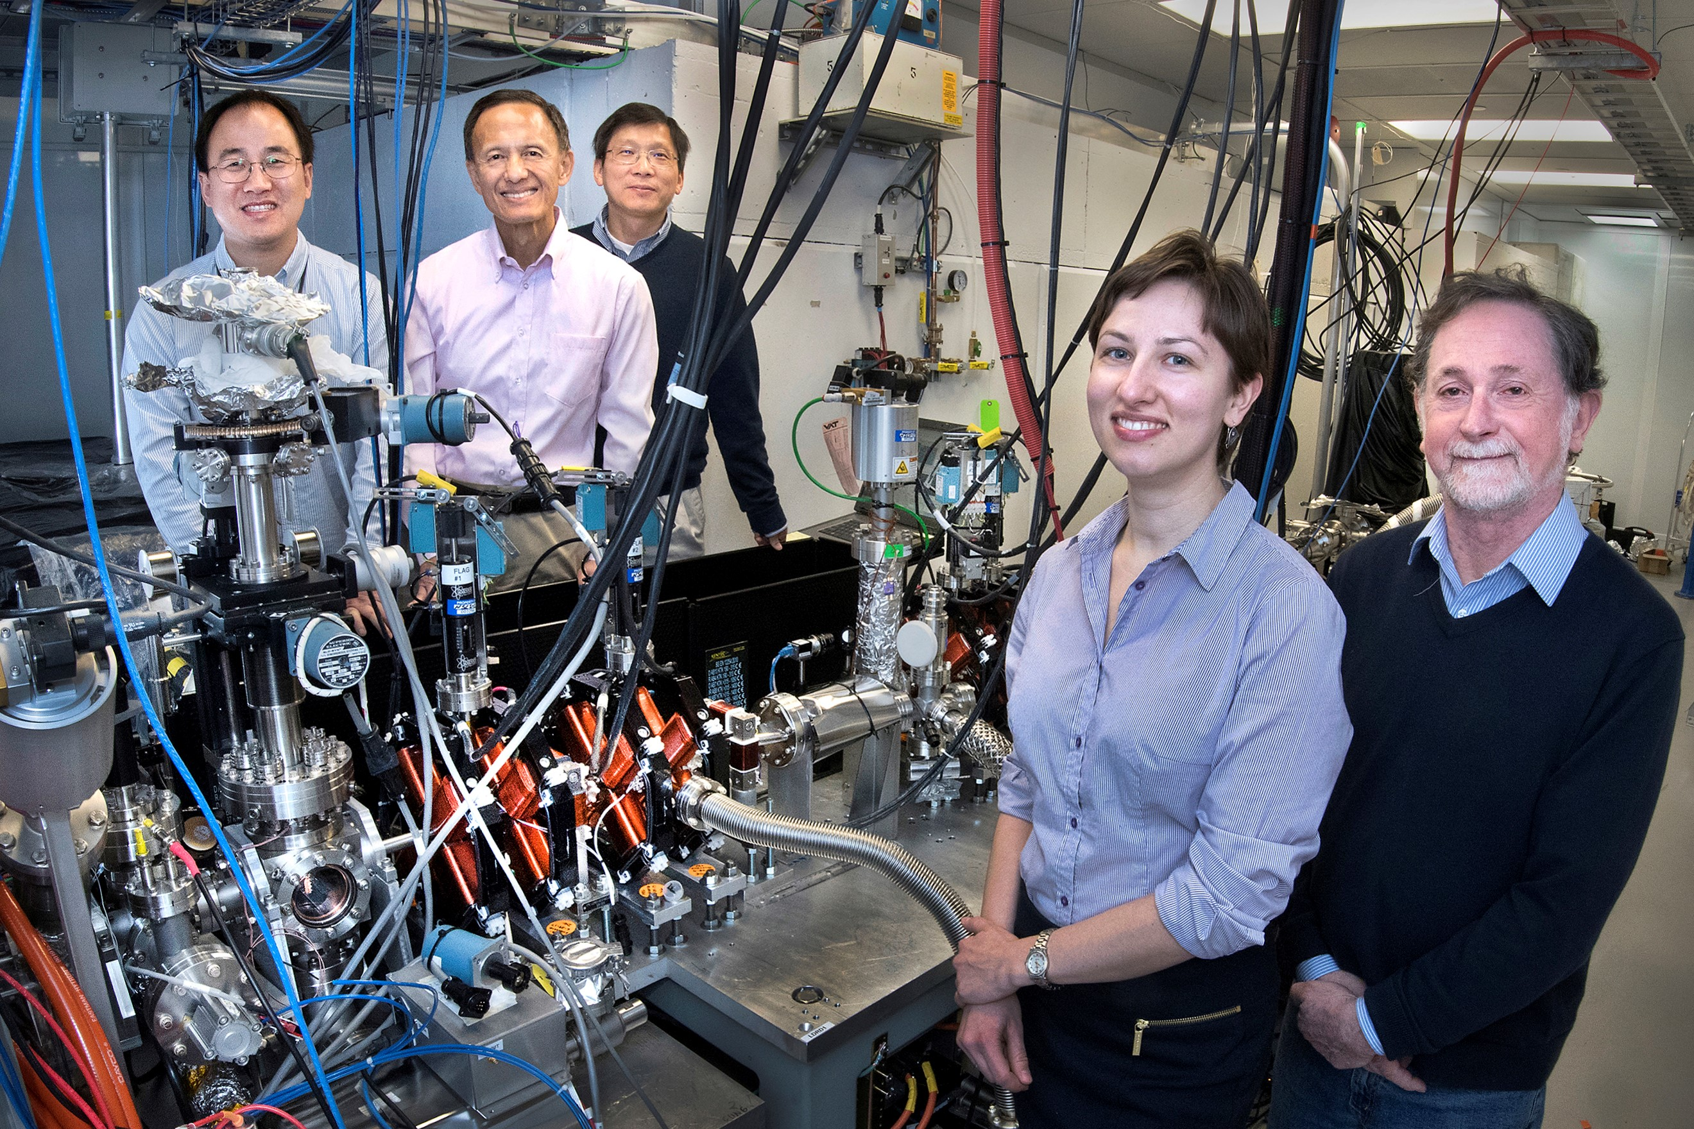


About Tatiana Konstantinova
BS, MS :
Appl Math and Appl Physics
PhD: Physics
Notes:
I enjoy extracting new signals from the data and discover the story behind the them. I have received BS and MS degrees from MIPT, where I went through an extensive mathematical training and did my thesis research in optics at ISAN. I did my PhD thesis research at BNL, where I devoted a lot of time and effort analyzing sequential diffraction data to understand fundamental interactions in crystals. Not only I got a chance to do cool science, but also to communicate it at different levels from peers and field experts, to DOE mangers and even to local community during laboratory open door events. I am excited about applying my skills to make impact in business world. I went to Insight to get exposure to data-related business problems and to transition to Data Science career.

Slide 8
tagged by alltrails.com
 | forest | beach | river | lake | waterfall
Forest | 77 | 1 | 16 | 0 | 11
Mountain | 86 | 0 | 17 | 0 | 12
Coast | 25 | 62 | 13 | 13 | 0
River/Lake | 82 | 9 | 19 | 100 | 16
Waterfall | 77 | 0 | 48 | 0 | 85
A bit of everything | 68 | 6 | 30 | 0 | 16
Clusters from photo labels

Slide 9
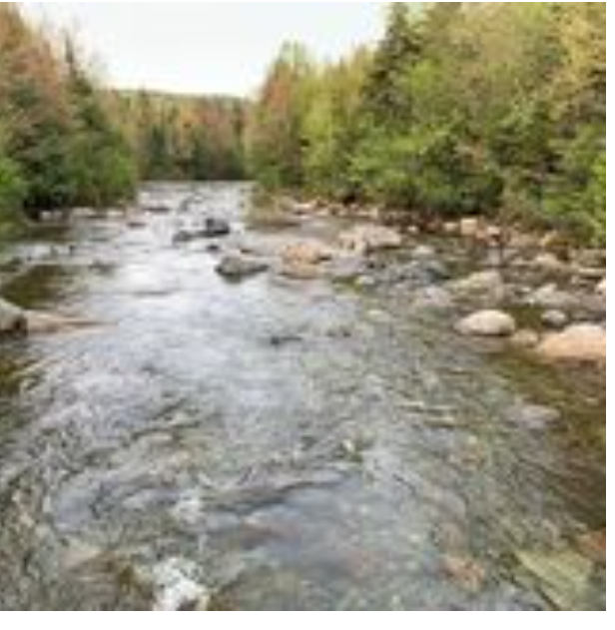

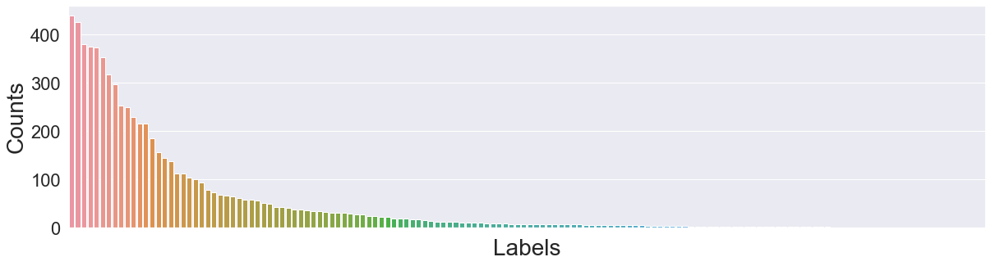
Visual Features
Labels | Probability
creek | 41.09 %
river | 15.60 %
swimming hole | 8.77 %
hot spring | 7.37 %
dam | 6.09 %
raft | 4.25 %
valley | 2.28 %
Average within the trail
Select top 5 for every trail
Cutting off 5%
63 left
85 cut
Notes:
Feature to add: photos of trails
Shorten methods

Slide 10
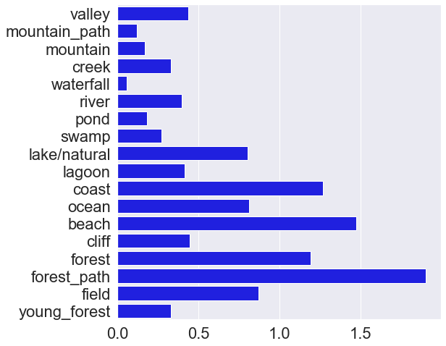
labels are more descriptive
Alltails.com tag “beach”
Coast category from clustering

Slide 11
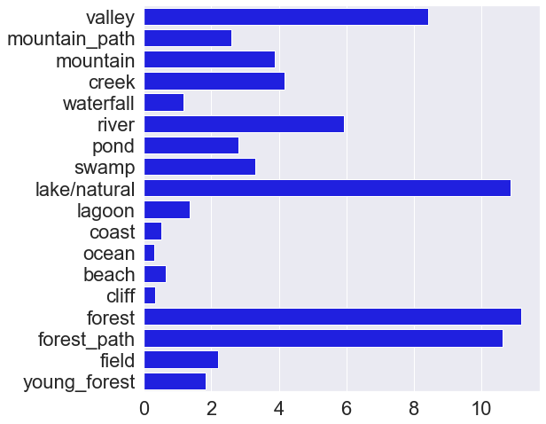
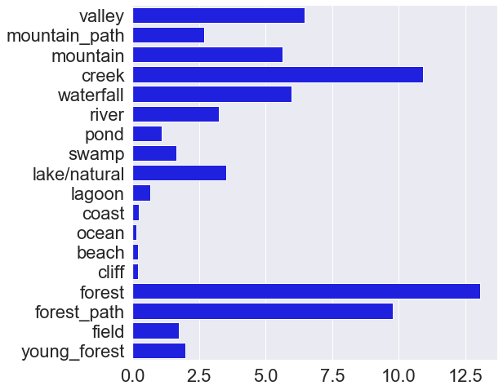
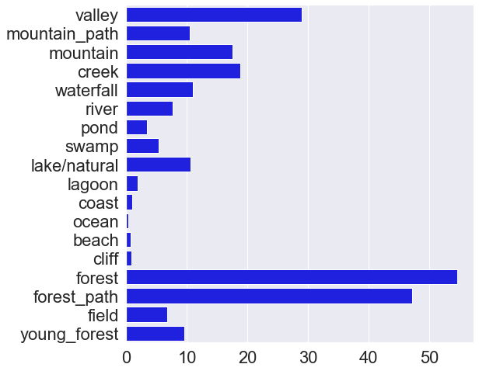
LAKE
RIVER
FOREST

Slide 12
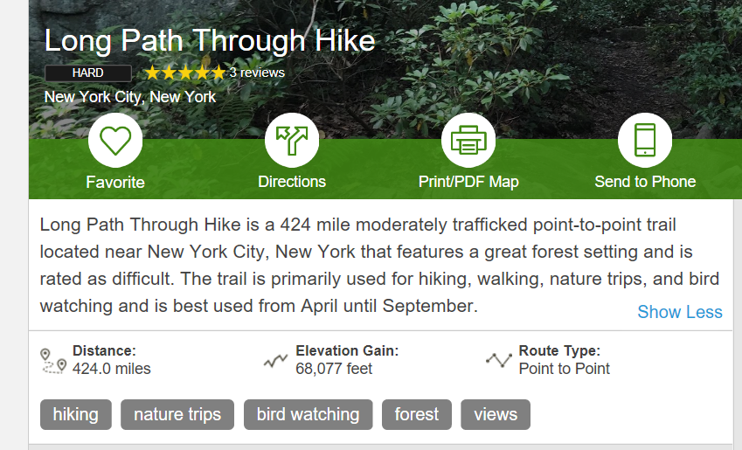
Outliers

Slide 13
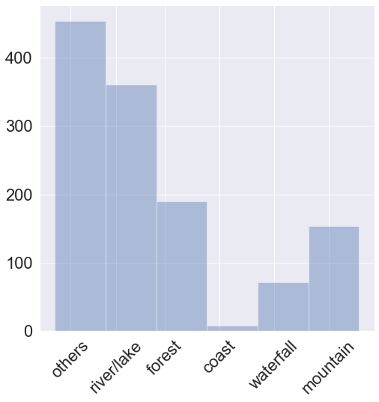
Cluster distribution

Slide 14
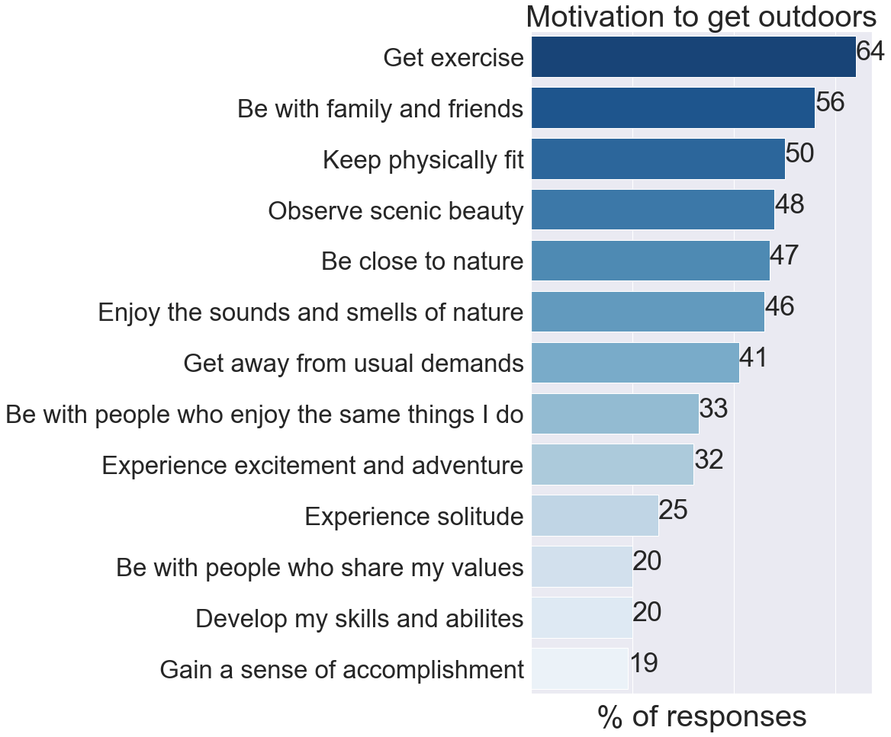

Slide 15
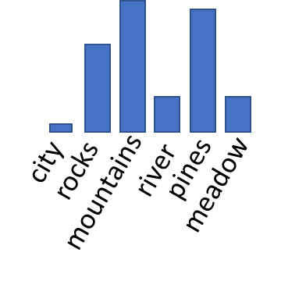

My approach
Trails characteristics:
Distance
Elevation gain
User data: favorite trail(s)
Unsupervised clustering
+
cosine similarity
train
Recommended trails
“Visual” features:
Photo content
Photos
Notes:
Add validations/ think about other approaches
What is the model

